Slide 1
Absenteeism from Preschool to High School
Elaine Allensworth, Stacy Ehrlich, Julia Gwynne,
Stuart Luppescu, Paul Moore, Amber Stitziel Pareja,
Todd Rosenkranz, David Stevens, and Marisa de la Torre
University of Chicago Consortium on Chicago
School Research
October 2013
Notes:
Elaine

Slide 2
Today’s presentation
How much of a problem is absenteeism in CPS?
Why do absences matter when the district goal is college & career readiness?
Why are students absent from school?
Can schools have much of an influence on attendance?
Not in today’s presentation
Differences in attendance by student background
Differences in attendance across the year

Slide 3
Definitions
Attendance rate = percentage of days present out of total days enrolled
Absence rate = percentage of days absent out of total days enrolled
Chronic absenteeism = missing 10% or more of days enrolled
Absences include excused, unexcused, suspensions, and course cutting
Notes:
Elaine

Slide 4
Part 1: How much of a problem is absenteeism in CPS?
It’s a big problem for many students in preschool and high school
It’s a problem for a smaller set of students in the elementary and middle grade years
Notes:
Elaine

Slide 5
Attendance is highest in grades 1 through 8
Source: CCSR analysis of 2011-12 CPS administrative data
Notes:
Julia
95% attendance can mask the problem

Slide 6
Almost half of students are chronically absent in preschool and high school
10% absence = 15 days in preschool
10% absence = 17 days in high school
Source: CCSR analysis of 2011-12 CPS administrative data
Notes:
JULIA
Talk about how attendance changes over the educational career. Look at the nature of the problem in preschool. Then in middle school and then in high school.
40 -50 % of students absent at the high school and most of these are extremely absent
Only enrolled students, doesn’t include students who for example would have dropped out by 11th grade and would have had bad attendance.
Most of the chronically absent students in high school miss 20% or more.
At the preschool level nearly 40 percent are absent.
Doesn’t look so bad in the primary and middle grades but 1 in 10 are missing 10 percent or more. Over three weeks of school.

Slide 7
In primary and middle grades Many of the same students are chronically absent year after year
Source: CCSR analysis of CPS administrative data 2008-09 to 2011-12
Notes:
JULIA
A lot of these are students that are beginning school with the lowest achievement levels.
If you look at CA third graders and the number years of CA

Slide 8
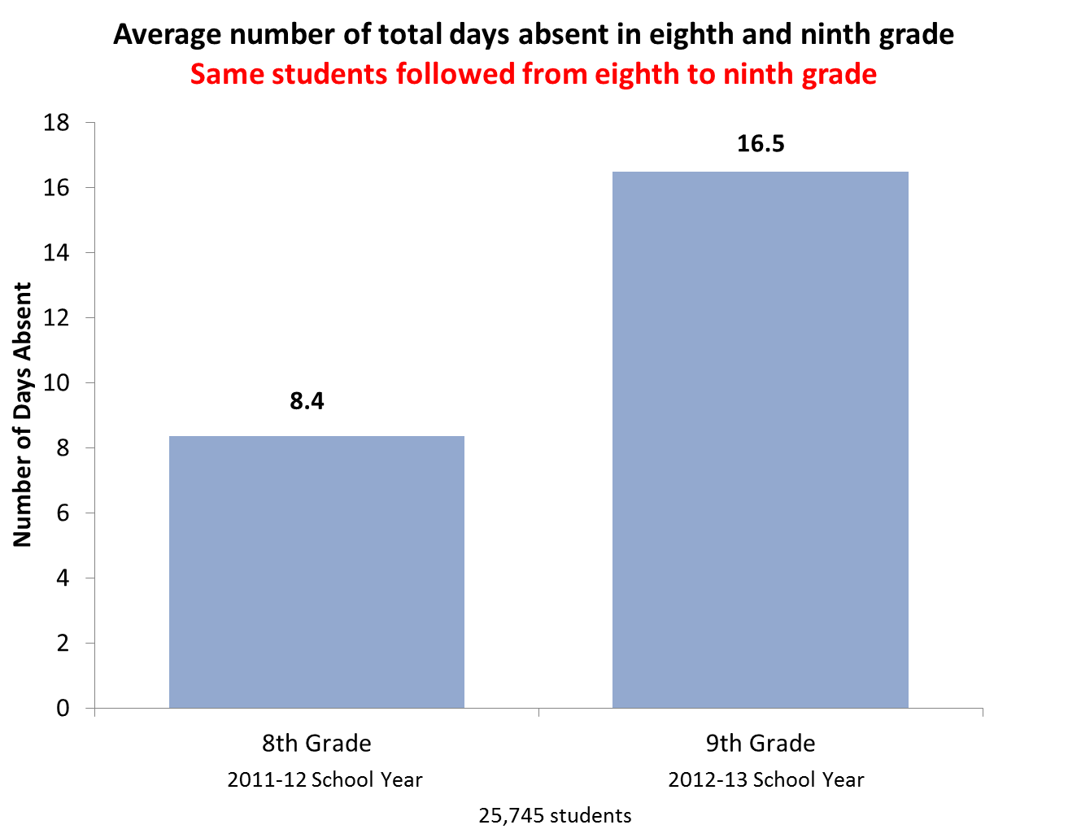
In high school Absences almost double from 8th to 9th grade
Source: Recreated from Rosenkranz, de la Torre, Stevens, & Allensworth (forthcoming); updated with 2011-12 to 2012-13 data
Notes:
JULIA
Some students are CA throughout elementary/middle, but a whole new group that is in high school
Whole new crop of students become chronically absent at the high school level.

Slide 9
Part 2: Do absences matter?
From preschool through high school, absenteeism has serious implications for students’ academic outcomes
Students who are chronically absent have:
Lower test scores
Lower likelihood of being on-track in high school
Lower likelihood of graduating
Lower course grades – taking them out of the running for college completion
Notes:
Elaine

Slide 10
In preschool Students with lower attendance have lower levels of kindergarten readiness
Kindergarten Readiness by Preschool Absence Rate, 2011-12
Absence
Rate:
Not Chronically Absent
Chronically Absent
* Indicates that scores are significantly different from scores of students who absent 0<3.3%, at p<.05 level; **p<.01; ***p<.001
Source: Ehrlich, Gwynne, Pareja, & Allensworth (2013)
Notes:
Stacy
Remember to reference the section them… do absences matter?

Slide 11
Multiple years of chronic absenteeism put students at risk for needing academic intervention
Second grade DIBELS scores by cumulative chronic absenteeism, 2011-12
Some risk⁺
At risk⁺
Indicates that scores are significantly different from scores of students who are never chronically absent, at p<.05 level; **p<.01; ***p<.001
⁺ As outlined in the DIBLES 6th Edition Assessment and Scoring Guide (Good & Kaminksi, 2002). Some risk indicates the need for additional intervention. At risk indicates the need for substantial interventions.
Source: Ehrlich, Gwynne, Pareja, & Allensworth (2013)
Notes:
Stacy
uncontrolled

Slide 12
Chronically absent middle grade students are very likely to be off-track for graduation in high school
Chronically absent
Source: Allensworth, Gwynne, Moore, & de la Torre (forthcoming)
Notes:
Elaine
Remember to reference the section them… do absences matter?
Relate to Philadelphia findings. Add lines for chronically absent. Same if go to 11th grade, but even fewer students on-track.

Slide 13
In middle grades Improving attendance is associated with much better high school outcomes
High school outcomes of students with the same attendance (97%) and test scores in 5th grade
Those with improved attendance by 8th grade
97% → 99% attendance
93% on-track
2.4 GPA
16 PLAN
Those with declining attendance by 8th grade
97% → 93% attendance
66% on-track
2.1 GPA
15 PLAN
On-track rates
Ninth grade GPA
10th grade PLAN composite score
Source: Allensworth, Gwynne, Moore, & de la Torre (forthcoming)
Notes:
Elaine

Slide 14
In middle grades Test score improvement is associated with less of boost for high school outcomes than improving attendance
High school outcomes of students with the same attendance (97%) and test scores in 5th grade
Those with improved attendance by 8th grade
97% → 99% attendance
93% on-track
2.4 GPA
16 PLAN
Those with strongly improving math scores by 8th grade
95th percentile test growth
77% on-track
2.2 GPA
16 PLAN
On-track rates
Ninth grade GPA
10th grade PLAN composite score
Source: Allensworth, Gwynne, Moore, & de la Torre (forthcoming)
Notes:
Elaine

Slide 15
In high school Absences hamper strong grades, even for high scoring students
23% high-scoring students are absent 20 days or more
Ninth Grade Absences
Source: CCSR analysis of CPS administrative data
Notes:
32% students absent fewer than 5 days

Slide 16
In high school Absences account for failure and declining grades
What explains course failures in 9th grade?
Demographic & economic background characteristics explain 7% of course failures
Eighth-grade test scores explain an additional 5% (12% total)
Student behaviors—absences and effort—explain an additional 61% (73% total)
Students’ GPAs drop by half of a point from 8th to 9th grade, and this is almost completely explained by the increase in absences.
Source: Allensworth & Easton (2007) and Rosenkranz, de la Torre, Stevens, & Allensworth (forthcoming)
Notes:
Marisa

Slide 17
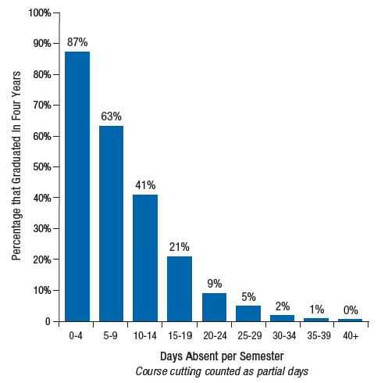
In high school Absence is very predictive of dropout/graduation
Each week of absence per semester in 9th grade lowers the likelihood of graduating by 25 percentage points
→ Chronically absent
Average ninth grade absences per semester
Based on incoming freshman in 2001-02
Source: Allensworth & Easton (2007)
Notes:
Marisa

Slide 18
Part 3: Why are students absent?
Many factors are common from preschool through high school
Health and health care
Family/background factors
Classroom and school factors
High school brings additional challenges
Notes:
Elaine
Student factors like health
Family/background factors like…

Slide 19
In preschool Health, logistics, and family-related reasons account for 80 percent of why children miss school
Note: "Other" includes school phobia, lack of sleep, religious observances, weather, safety issues, and a general other category.
Source: Ehrlich, Gwynne, Pareja, & Allensworth (2013)
Notes:
Stacy
Health is overwhelmingly the most common reason why preK children miss school.
Over 60% due to medically-related reasons.
The purple bars represent some other obstacles that families face (to be described more on next slide)

Slide 20
In preschool Besides illness, there are many obstacles that families face
Obstacles families face
Trouble getting child to/from school
Parent/sibling sick
Family emergency
Child care issues
Some family circumstances can make managing these obstacles more difficult
Single parenthood, poor parental health, using public transportation to school, living in poverty
Source: Ehrlich, Gwynne, Pareja, & Allensworth (2013)
Notes:
Stacy

Slide 21
In middle school and high school, illness is the primary reason for absences; other reasons become more common in high school
Source: CCSR analysis of 2007 student survey data
Notes:
david

Slide 22
The same students have many more unexcused absences in 9th grade than in 8th grade
Source: Based on Rosenkranz, de la Torre, Stevens, & Allensworth (forthcoming); updated with 2011-12 to 2012-13 data
Notes:
david

Slide 23
In high school There are additional reasons for missing school
High school context makes it more difficult for teachers to monitor and address student behavior
Problems getting to school on time
Transportation issues—buses, distance
Safety
Avoiding fights
Increased suspensions
 | % Suspended | Average # Days
8th grade (2011-12) | 14 | 4. 8
9th grade (2012-13) | 21 | 5.7
Source: CCSR analysis of 2009-10 CPS student interviews and
2011-12 to 2012-13 CPS administrative data
Notes:
david

Slide 24
In high school Classroom factors matter: The same student often has different attendance in different classes
Some teachers’ students miss 13 days more per semester than other teachers’ students
Among teachers who share the same students, and controlling for structural characteristics of the class
Students are more likely to attend some of their classes than others:
In the middle of the day (not 1st or 9th/10th period)
Their smaller classes – those with fewer students
Their classes with higher-achieving peers
Source: Allensworth & Luppescu (forthcoming)
Notes:
Elaine
Attendance varies almost as much across a typical student’s classes as it does across students.
Teachers’ students vary by 13 days per semester—almost 3 weeks (2 s.d.), even after controlling for WHO and WHAT they teach.

Slide 25
Absence rates vary substantially among high schools serving students with similar levels of incoming achievement
Academic Composition
Based on incoming freshman in 2004-05
Source: Allensworth & Easton (2007)
Notes:
Elaine
Attendance is the biggest determinant of course failure, and attendance is something that varies considerably by school—even if we look at similar students in schools serving similar types of students.

Slide 26
Part 4: Can schools have much of an influence on attendance?
Yes!
Schools with more supportive environments have better attendance than other schools serving similar students
There have been substantial improvements over the last few years
Notes:
Elaine

Slide 27
Among high schools serving similar students, school culture and organization makes a difference
School factors associated with significantly stronger attendance than other schools (in order of importance):
Teacher-student trust
Schoolwide press for college
Teacher monitoring & personal support
Classroom personalism
Collective responsibility among teachers
Relevance of coursework for the future
School safety
Comparing schools serving similar students
Source: Allensworth & Easton (2007)
Notes:
Marisa

Slide 28
Attendance has improved considerably in CPS high schools since 2007-08
Source: CCSR analysis CPS administrative data of 2007-08 to 2012-13
Notes:
Marisa

Slide 29
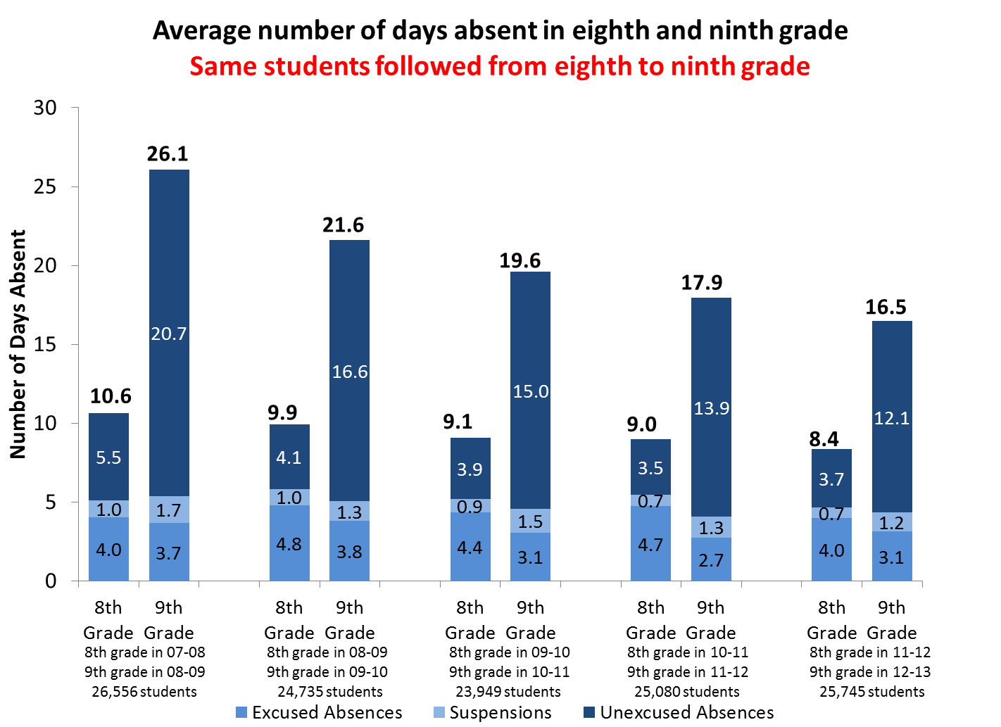
In high school, improvements in attendance have come from fewer unexcused absences
Source: Based on Rosenkranz, de la Torre, Stevens, & Allensworth (forthcoming); updated with 2007-08 to 2012-13 CPS administrative data
Notes:
Marisa

Slide 30
Systems and programs that promote better monitoring and support have shown improvements in attendance
On-track data tools
Check & Connect
ALAS
May also be a need for coordination with other sectors
Health care
Transportation
Safety
Notes:
Elaine
Working on attendance is a pathway to personalization

Slide 31
References Allensworth, E. M., and Easton, J. Q. (2007). What matters for staying on-track and graduating in Chicago Public Schools. Chicago, IL: Consortium on Chicago School Research at the University of Chicago. http://ccsr.uchicago.edu/publications/what-matters-staying-track-and-graduating-chicago-public-schools Allensworth, E. M., Gwynne, J. A., Moore, P. T., and de la Torre, M. (forthcoming). Looking forward to high school and college: Middle school indicators of readiness in Chicago Public Schools. Chicago, IL: University of Chicago Consortium on Chicago School Research. Allensworth, E. A., and Luppescu, S. (forthcoming). Why do students get good grades (or bad ones)? Student, teacher, class structure and school effects on student achievement in high school. Chicago, IL: University of Chicago Consortium on Chicago School Research. Ehrlich, S. B., Gwynne, J. A., Pareja, A. S., and Allensworth, E. M. (2013). Preschool attendance in Chicago Public Schools: Relationships with learning outcomes and reasons for absences. Chicago, IL: University of Chicago Consortium on Chicago School Research. http://ccsr.uchicago.edu/publications/preschool-attendance-chicago-public-schools-relationships-learning-outcomes-and-reasons Rosenkranz, T., de la Torre, M., Stevens, W. D., and Allensworth, E. M. (forthcoming). Free to fail: Why grades drop when student enter high school and what adults can do about it. Chicago, IL: University of Chicago Consortium on Chicago School Research.

