Slide 1
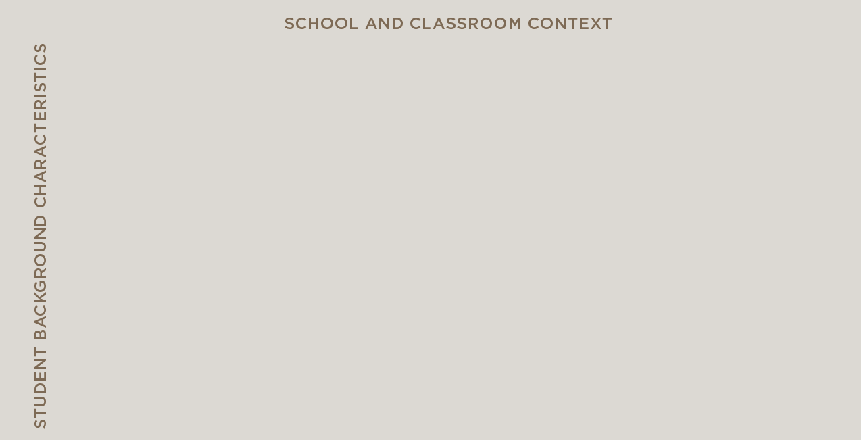
SOCIO-CULTURAL CONTEXT

Slide 2
SOCIO-CULTURAL CONTEXT

Slide 3
SOCIO-CULTURAL CONTEXT

Slide 4
SOCIO-CULTURAL CONTEXT

Slide 5
SOCIO-CULTURAL CONTEXT

Slide 6
SOCIO-CULTURAL CONTEXT

Slide 7
SOCIO-CULTURAL CONTEXT

Slide 8
SOCIO-CULTURAL CONTEXT

Slide 9
SOCIO-CULTURAL CONTEXT

Slide 10
SOCIO-CULTURAL CONTEXT

Slide 11
SOCIO-CULTURAL CONTEXT

Slide 12
SOCIO-CULTURAL CONTEXT

Slide 13
SOCIO-CULTURAL CONTEXT

Slide 14
SOCIO-CULTURAL CONTEXT

Slide 15
SOCIO-CULTURAL CONTEXT

Slide 16
SOCIO-CULTURAL CONTEXT

Slide 17
SOCIO-CULTURAL CONTEXT

Slide 18
SOCIO-CULTURAL CONTEXT

Slide 19
SOCIO-CULTURAL CONTEXT

Slide 20
SOCIO-CULTURAL CONTEXT

Slide 21
SOCIO-CULTURAL CONTEXT

